Slide 1
TEAM TODDLERS
HackTheVerse
Domain : Health
Prepared by :
Tanjim Ahmed Khan
Nazmul Takbir
Jayanta Sadhu
Sihat Afnan

Slide 2
Developments in medical technology have long been confined to procedural or pharmaceutical advances, while neglecting a most basic and essential component of medicine: patient information management.
- John Doolittle
American lawyer and politician

Slide 3
Features
Reception system
Data transfer and analysis
Patient monitoring
Emergency situation handling

Slide 4
Reception System
1

Slide 5

Patient Assignment
Our reception system assigns each patient to a correct department of the hospital based on his primary symptoms during admission.
The system automatically appoints a particular doctor and a particular nurse from that department to treat that patient.

Slide 6
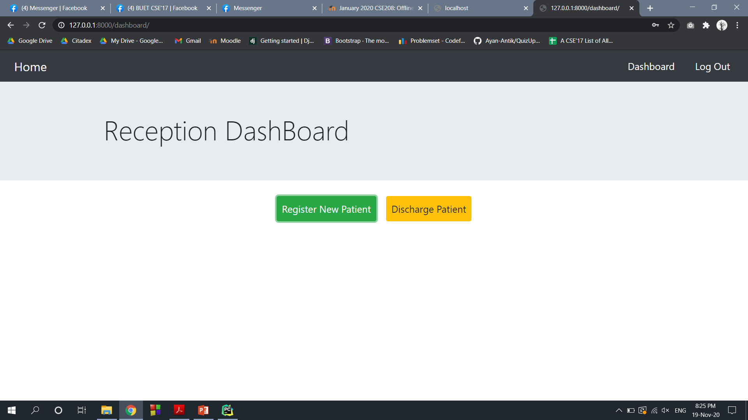
Patients are assigned to doctors and nurses in such a way that the patients under a particular health worker are allotted beds in the same floor/ward.

Slide 7
Data Transfer and Analysis
2

Slide 8
Data Transfer
Medical Sensors
Apache Kafka
Main Server

Slide 9
Data Classification Based on Time
Recent Data
Used to judge immediate condition of patient ( emergency or not )
Historical Data
For analysis purpose
very frequently collected ( 30s )
Since it is impractical to store so much data over a very long time, recent 100 data points are kept for each patient ( 1hr )
Data stored over several days at 30 minute interval (no upper limit of number of data records )

Slide 10

Data Analysis
Analysis of historical data of a particular patient can be used to understand how that particular patient is reacting to the treatment being given to him. Analysis of historical data of all the patients can be used to understand which particular method of treatment is working well for the population as a whole.
Analysis of recent data is used to detect possible emergency situations and alert the healthcare workers accordingly.

Slide 11
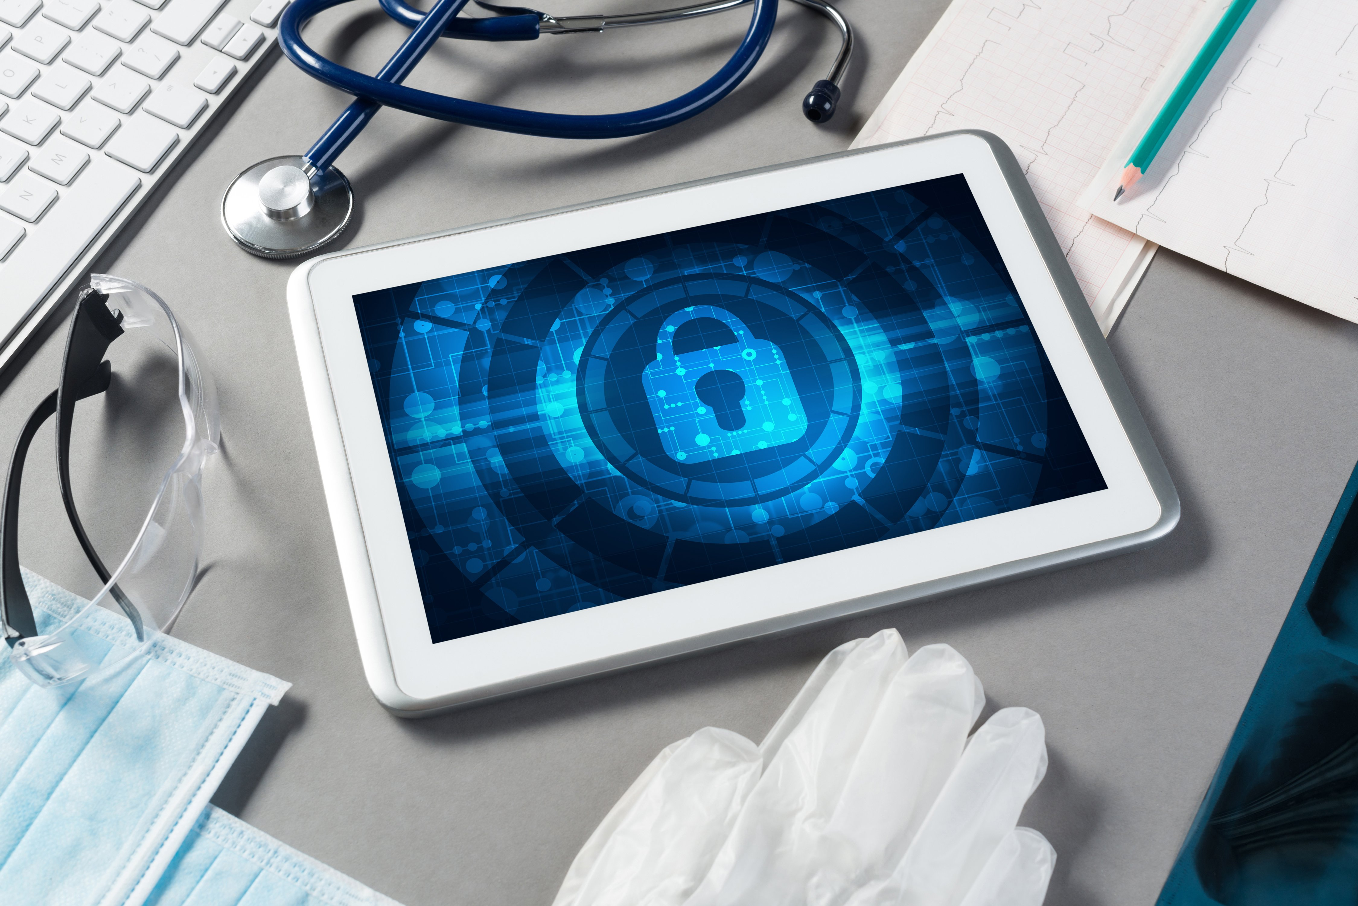
Data Safety
Data of individual patient is visible only to the doctors and nurses assigned to take care of that patient. It is not publicly available to prevent any possible abuse of private medical data of the patient.
Data which describe all the patients as a whole is made publicly available because this provides insight into which particular methods of treatment are working well and can benefit the medical community as a whole.

Slide 12
Patient Monitoring
3

Slide 13
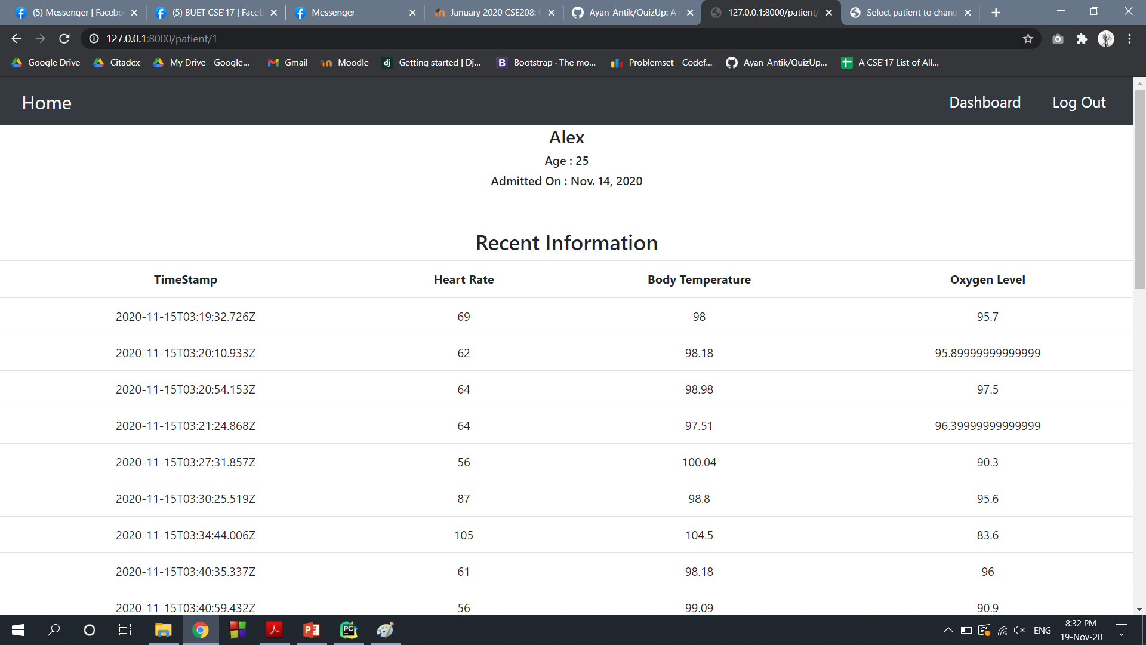
Doctors and nurses can log into their account any time and see information and conditions of all patients under them.
They can view both recent condition and historical state of each patient.

Slide 14
Emergency Situation Handling
4

Slide 15
EMERGENCY DETECTION
If we were domain experts we could have come up with the best metrics.
For now, we monitor the input from sensors and send an emergency message if the sensor readings are beyond specified thresholds.
Our rough metric is based on the mean and variance of recent data for a particular patient.
Our idea is to set the system with low thresholds so that during failure, there are more false positives than false negatives.

Slide 16
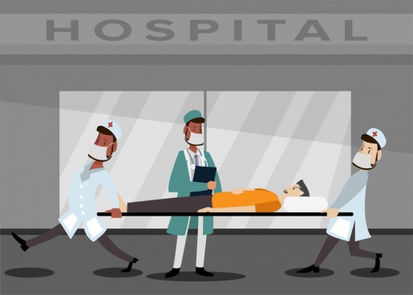



Notify and Alert
Every doctor and nurse carries a beeper with him/her.
If emergency situation arises, notification will be sent to assigned doctors and nurses.
If the targeted person doesn’t respond, the message will be forwarded to other doctors and nurses of the same department.
If the number of serious patients crosses a certain number or the second stage notification fails, a central alarm system is activated for backup team.

Slide 17
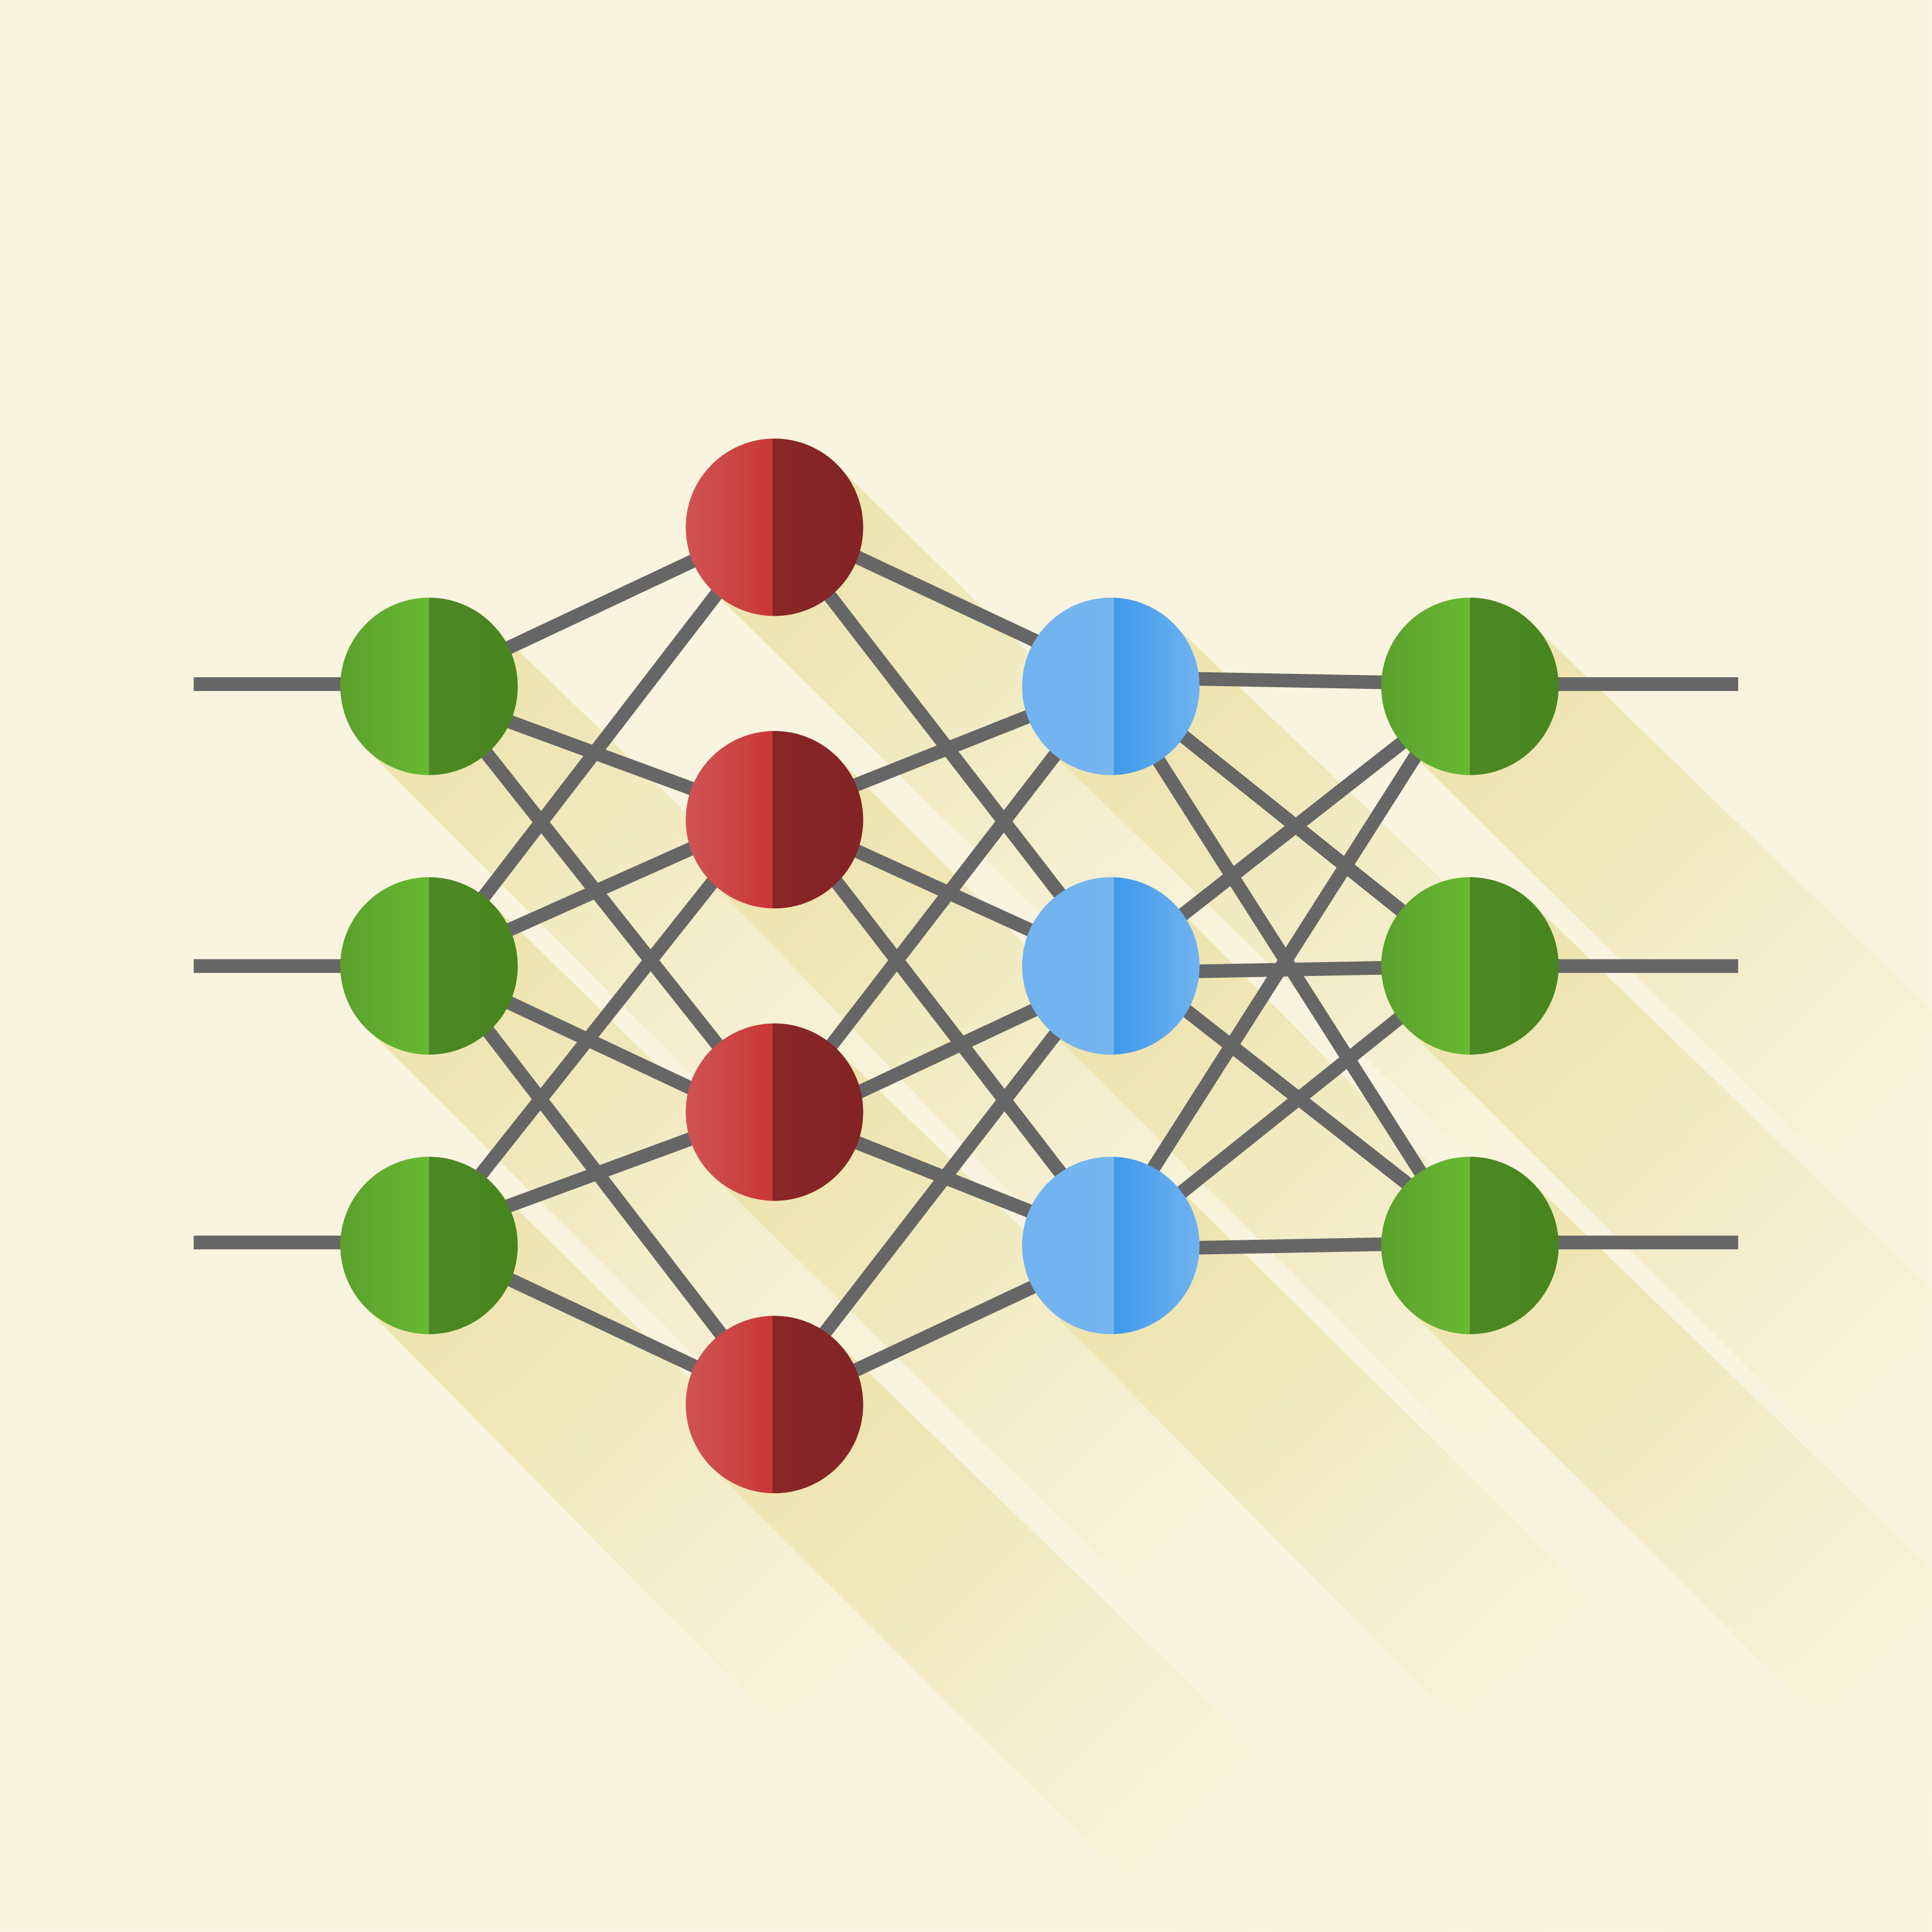
Idea for further improvement
After several months of data collection and feedback from the health care workers, we can build a machine learning model (logistic regression, XGBoost etc) for our emergency system which will eventually improve the prediction performance of the system.

Slide 18
Demo Video
5

Slide 19
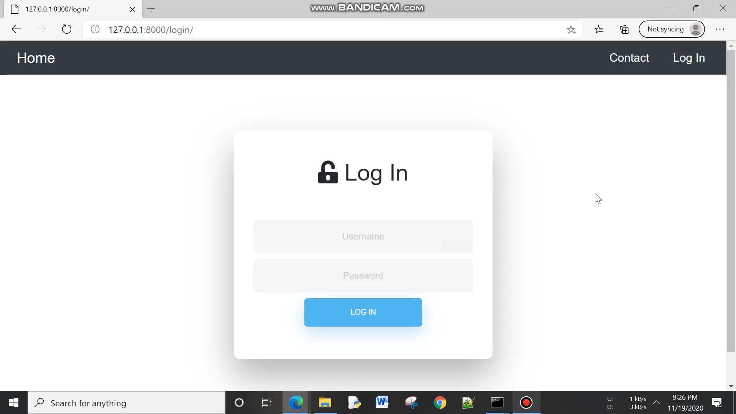

Slide 20
Thanks Everyone!

